Slide 1
Hackathon’25 : Solve Rubik’s Cube

Slide 2
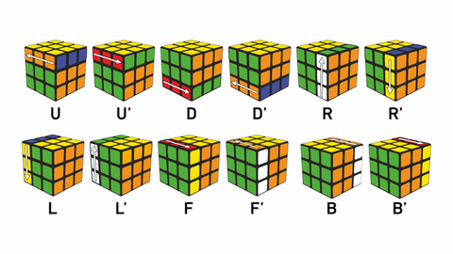
Solve Rubik’s Cube
Overview
Participants are challenged to design and implement an algorithm that can solve a standard 3x3 Rubik’s Cube from any scrambled state. The solution must mimic the real-world logic of solving a cube through a sequence of valid moves.
What We’re Looking For : 🔍
Problem-Solving Approach
How do you break down the problem?
How do you model the cube’s state and transitions?
Use of Data Structures
How do you represent the cube internally (e.g., arrays, trees, graphs)?
Use of efficient structures to track states and operations.
State Prediction Logic
Ability to track and predict cube state after each move.
Design of a move engine to simulate rotations and track permutations.
Algorithm Efficiency
How fast can your solution reach the solved state?
Complexity (time and space) of your algorithm.
Bonus Evaluation Areas
Creativity in solution design.
Visual simulation or cube UI (optional but Wow factor).
Scalability for different cube sizes (2x2, 4x4, etc.) : Optional
Deliverables:
Working algorithm (code)
Brief walkthrough/presentation of your approach
Output example(s) from your solver
It’s Not Just a Puzzle - It’s a Test of Mind, Math, and Moves!

Slide 3
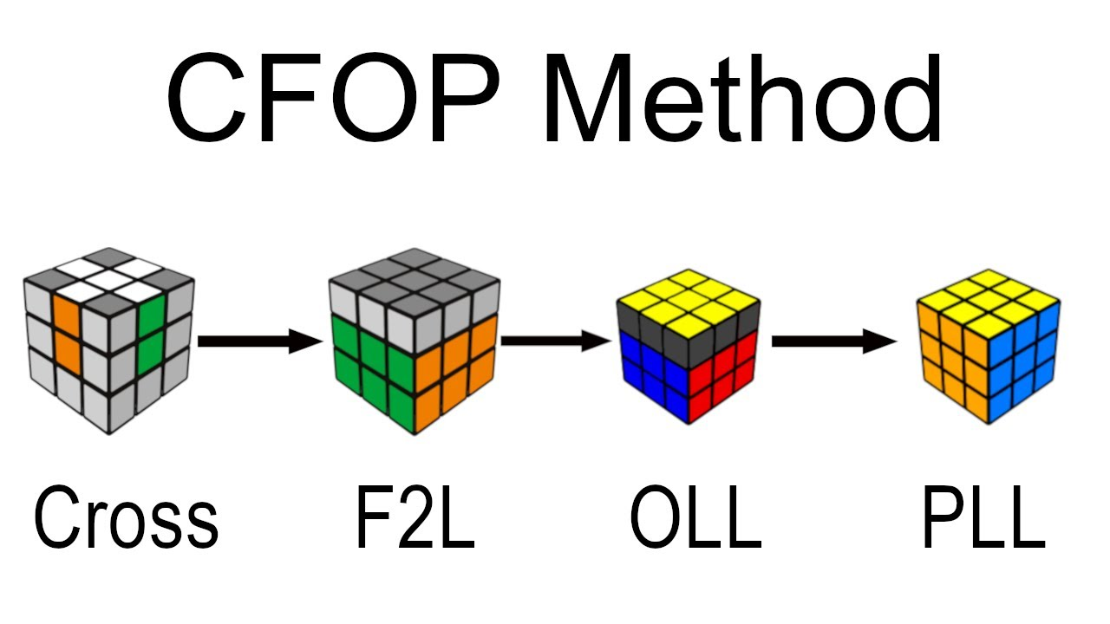
Problem Solving Approach
Breaking down the problem
Cross: Solve the bottom layer cross (4 edges)
F2L: First Two Layers (4 corner-edge pairs)
OLL: Orient Last Layer (58 possible cases)
PLL: Permute Last Layer (22 possible cases)
Breaking down complex 3D puzzles into sequential 2D pattern recognition problems enables human-like solving strategies that are both intuitive and computationally efficient.

Slide 4
Problem Solving Approach
Model Cube’s state and transitions
State Representation
Transition Modelling
Decision Trees & Lookup Tables
6×9 Integer Array Structure:
6 faces: Front, Right, Back, Left, Up, Down
9 squares per face
Colors as integers: 0-5 (Green, Red, Blue, Orange, White, Yellow)
Move System: 9 basic moves (F, R, B, L, U, D, M, E, S)
Algorithm Parser: Standard cube notation (R, U', F2, etc.)
State Validation: Ensures physically possible cube configurations
Pattern Recognition: Mathematical lookup tables for OLL/PLL cases
Cross Solving: 6 orientation cases with position scanning
F2L Solving: 11 comprehensive case handlers (3600+ lines)
Last Layer: Smart pattern matching using modular arithmetic
a) OLL: 12-boolean pattern recognition
b) PLL: Outer ring color sequence analysis
Modeling cube state as structured arrays with mathematical lookup tables transforms physical rotations into fast algorithmic pattern matching.

Slide 5
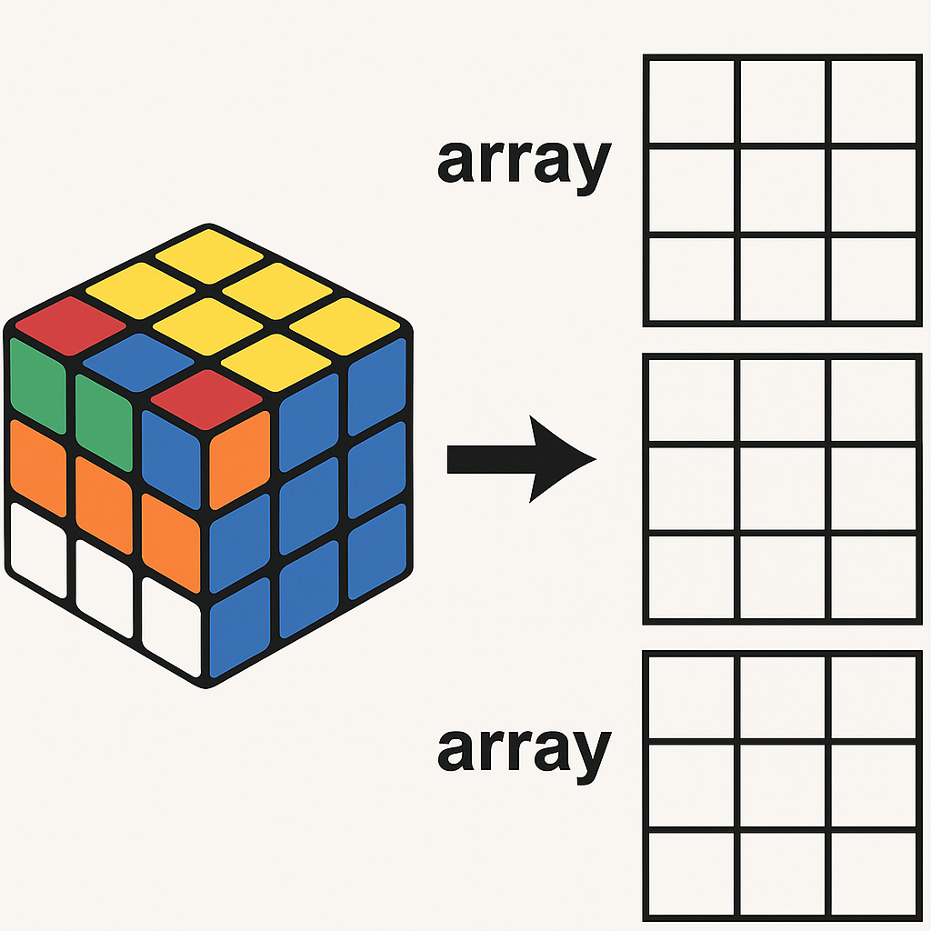
Use of Data Structures
Internal Cube Representation
Core Cube Structure:
int cube[6][9]; // 6 faces × 9 squares
Specialized Data Structures:
struct oll {
char name[25]; // Algorithm name
bool pattern[12]; // 12-boolean arrays for yellow/non-yellow detection
char algorithm[100]; // Solution moves
};
struct pll {
char name[25]; // Algorithm name
int pattern[12]; //12-integer arrays for outer ring color sequences
char algorithm[100]; // Solution moves };
Simple 2D arrays combined with mathematical pattern recognition eliminate the need for complex graph traversal or tree structures.

Slide 6
Use of Data Structures
Efficient structures to track states and operations
Memory-Optimized Lookup Tables | Operation Tracking | State Management
58 OLL Cases: Loaded once, O(1) pattern matching 22 PLL Cases: Mathematical modular arithmetic for recognition CSV-Based Storage: Dynamic loading with error handling | // Move execution with cycle operations void cycle(int *a, int *b, int *c, int *d); // Efficient 4-element rotation for edges/corners // Algorithm parsing and execution void run_algorithm(int cube[6][9], char* algorithm); // Batch move processing with standard notation | Move History: Dynamic string arrays for solution tracking Animation Queue: JavaScript arrays for 3D visualization Memory Safety: Automatic cleanup with free_strings() and cleanup_last_layer()
Precomputed lookup tables with O(1) access transform exponential search problems into constant-time pattern matching.

Slide 7
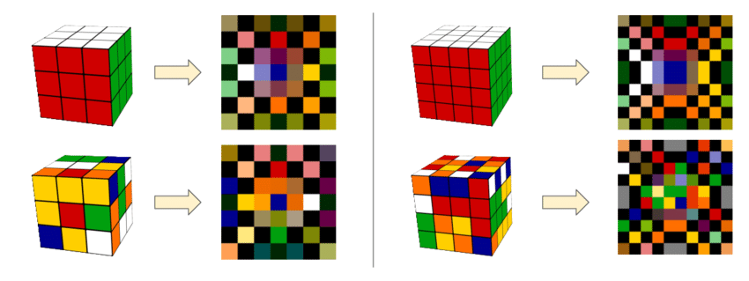
State Prediction Logic
Ability to Track and Predict Cube State After Each Move
Direct State Calculation
Deterministic Permutations: Each move produces a mathematically predictable result
100% Accuracy: Exact state known after any move sequence
In-Place Modification: move_cube() function modifies cube array directly
Real-Time Tracking: State updated immediately with each operation
Core Tracking Mechanism
Function: move_cube() in src/cube.c handles all state transitions
Data Structure: Direct manipulation of int cube[6][9] array
Algorithm Processing: run_algorithm() chains multiple moves for complex sequences
No Prediction Needed: Mathematical certainty eliminates guesswork
Deterministic permutation mathematics eliminates the need for prediction algorithms, ensuring 100% accurate state tracking.

Slide 8
State Prediction Logic
Design of Move Engine to Simulate Rotations and Track Permutations
01
02
03
Move Engine Architecture
Visualization Engine Integration
Engine Features
Switch-Based Logic: move_cube() uses switch statement for 9 possible moves
Cycle Operations: cycle() function handles 4-element sticker rotations
Move Types: F, R, B, L, U, D faces + M, E, S slice moves
Recursive Execution: Supports multiple iterations (e.g., R2, U')
JavaScript Mirror: moveInstructions dictionary defines same permutations
3D Animation: Three.js visualizes the mathematical transformations
Cycle Mapping: Direct correspondence between C logic and visual representation
Standard Notation: Parses R, U', F2, x, y, z moves
Batch Processing: Handles complete algorithms in single function call
Error Handling: Validates moves before execution
Memory Efficiency: In-place operations minimize memory usage
Deterministic permutation mathematics eliminates the need for prediction algorithms, ensuring 100% accurate state tracking.

Slide 9
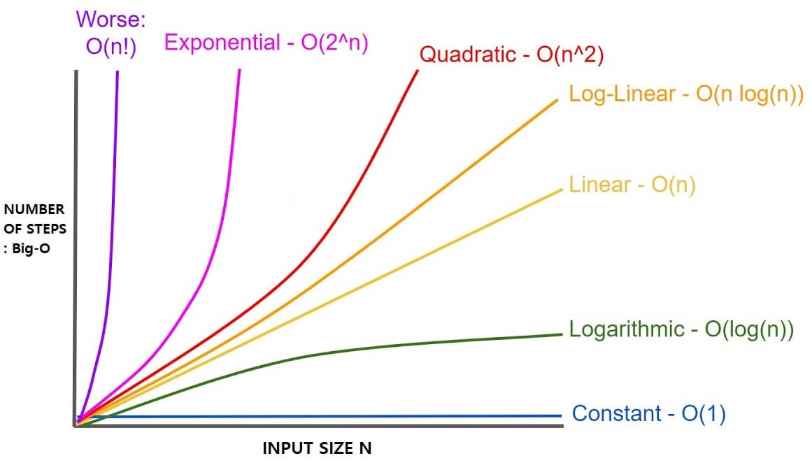
Algorithm Efficiency
Time Complexity: O(1) - Constant Time
T(total) = T(cross) + T(f2l) + T(oll) + T(pll)
Cross: Max 5 iterations × 6 case checks = O(30) = O(1)
F2L: 4 pairs × 11 case functions = O(44) = O(1)
OLL: Fixed lookup in 58 patterns = O(58) = O(1)
PLL: Fixed lookup in 22 patterns = O(22) = O(1)
Result: T(total) = O(1) + O(1) + O(1) + O(1) = O(1)
Space Complexity: O(1) - Constant Space
Space(total) = Cube + Algorithms + Auxiliary
Cube State: int cube[6][9] = 54 × 4 bytes = 216 bytes
OLL Storage: 58 cases × ~28 bytes = 1,624 bytes
PLL Storage: 22 cases × ~64 bytes = 1,408 bytes
Solution String: Max ~200 characters = 200 bytes
Total: ~3.4 KB (constant, independent of scramble)
Note:
Traditional Search: O(b^d)
Our Method: O(1)
Real Performance: <0.1 seconds for complete solution
Fast and efficient complexity results in good performance.

Slide 10
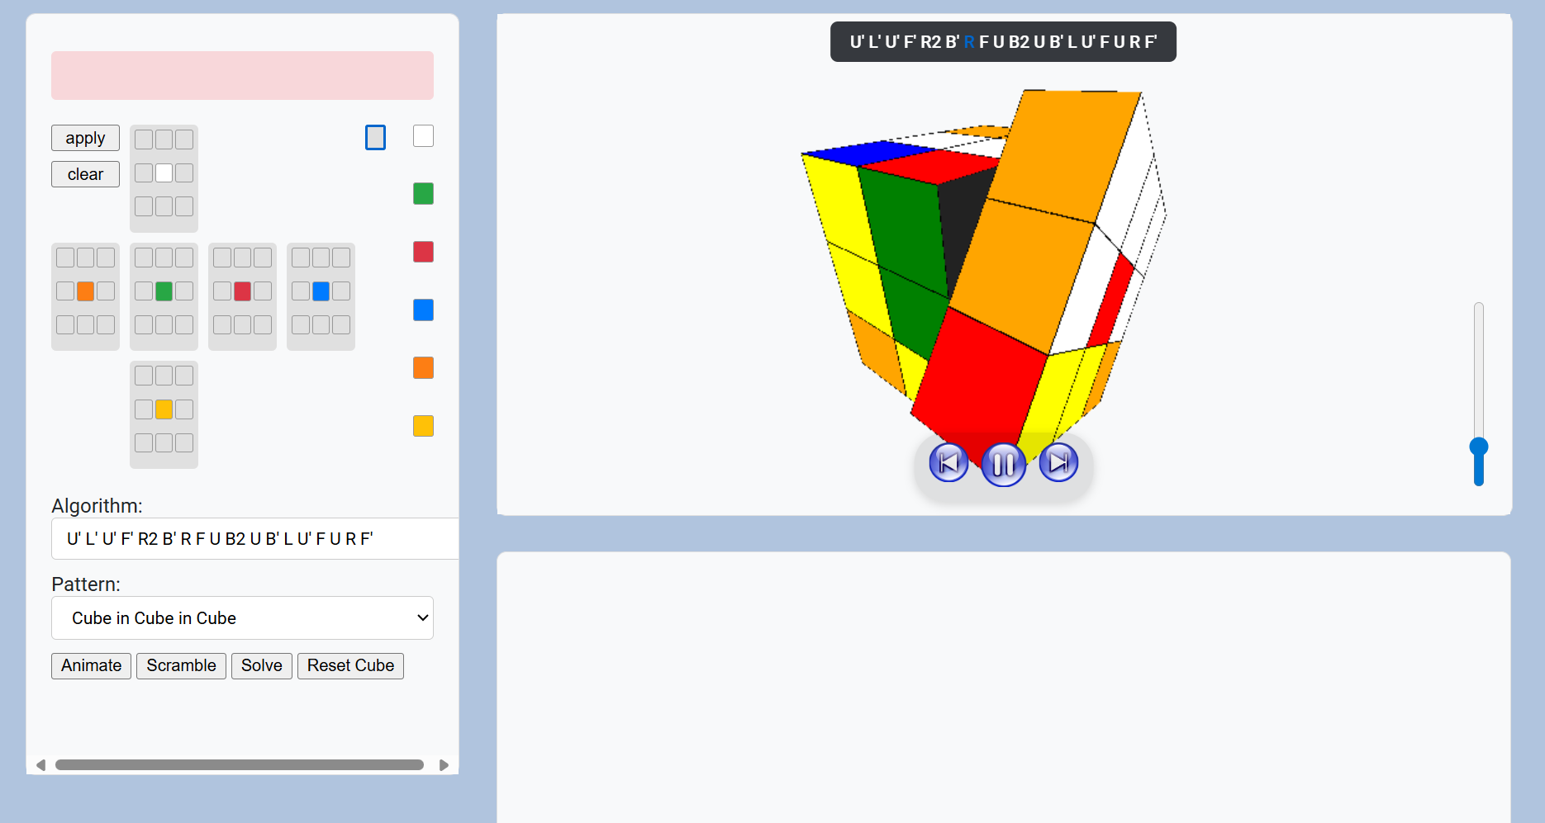
Project demonstration and Output pics
https://github.com/jetsu03/Rubiks-cube-solver
To access the project folder, click the above link.
Visual simulation
Creativity
Project demonstration to showcase the working of the algorithm

